Slide 1

Low Power VLSI Design
By
Dr. Aruru Sai Kumar
Assistant Professor Sr. Grade -2
School of Electronics Engineering (SENSE)

Slide 2
MODULE-3:Low-Voltage Low-Power circuits
Introduction
Circuit design style-clocked and non-clocked logics
Leakage current in deep sub micrometer transistors
Deep sub micrometer device design issues.

Slide 3
Outline
Circuit design style-clocked logic
Circuit design non-clocked logic
Leakage current
Deep sub micrometer device design issues.

Slide 4
3.1 CLOCKING PURPOSE
Synchronous systems use a clock to keep operations in sequence
Distinguish this cycle from previous cycle or next cycle
Determine speed at which machine operates
Clock must be distributed to all the sequencing elements
Flip-flops and latches
Also distribute clock to other elements
Domino circuits and memories
Clocking overhead % increases as the frequency is increased.

Slide 5
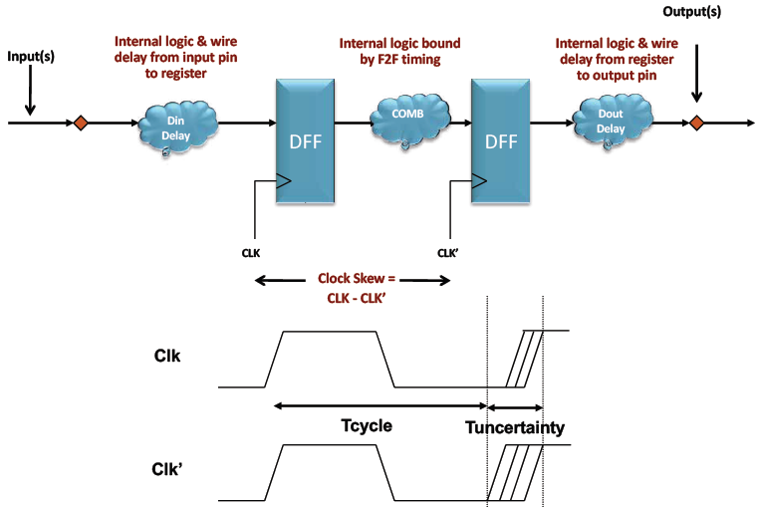
CLOCK DISTRIBUTION
On a small chip, the clock distribution network is just a wire
And possibly an inverter for clk.
On practical chips, the RC delay of the wire resistance and gate load is very long
Variations in this delay cause clock to get to different elements at different times
This is called clock skew
Most chips use repeaters to buffer the clock and equalize the delay.
Hence reduces but does not eliminate skew.
CLOCK DEPENDANCE

Slide 6
Power Dissipation in Clock Distribution
G Hz range in submicron technology.
PD is limiting factor.
Power drain can be seen in portable device like wireless computing and communication systems because of performance driven paradigm.
key stage in optimizing the design to achieve performance and cost goals is Layout or Physical design.
low power considerations were given in
floorplan stage
placement and routing techniques
The synchronization of a digital system requires one or more reference signals to coordinate and insure correct sequences of operations.
Fully synchronous operation with a common clock has been the dominant design approach for digital systems.

Slide 7
Power Dissipation in Clock Distribution
A clock tree is usually constructed to globally distribute the clock signal to all modules throughout the system.
The transitions of clock signal provide the reference time for each module to latch in data, trigger operations and transmit outputs.
Clock is the most important signal in determining system performance and total PD.
Example Typical Values for a chip (DEC Alpha Chip) uses a clock driver
CL=3250 pF
F= 200 MHz,
Operating Voltage= 3.3 V,
Pdynamic=7.08 W,
30% of the chip's total power dissipation.

Slide 8


Power Dissipation in Clock Distribution
Dynamic power dissipated by switching the clock
CL= Total Load
Cd= Clock driver capacitance
N= total No of clock terminals, Cg=input capacitance at each terminal
Cw=Unit Length wire capacitance, D= Chip dimension
α= estimation factor depending on algorithm used for local clock routing.
Effect of CLOCK on chip
PD increases by clock as the number of clocked devices and chip dimension increases.
Global clock effects 30-40% of the total system PD.
For Low Power clock distribution, less N, less Cw, less Cd were chosen.
Controlled clock skews within small or tolerable values.
Clock phase delay has to be controlled for better system throughput.

Slide 9
Clock Skew
The difference between arrival times of clocks at different devices is called Clock skew.
Factors causing Clock Skew :
Interconnect Length
Temperature Variations
Capacitive Coupling
Material Imperfections
Differences in input capacitance on the clock inputs
Types of Clock Skew :
Positive Skew
Negative Skew

Slide 10
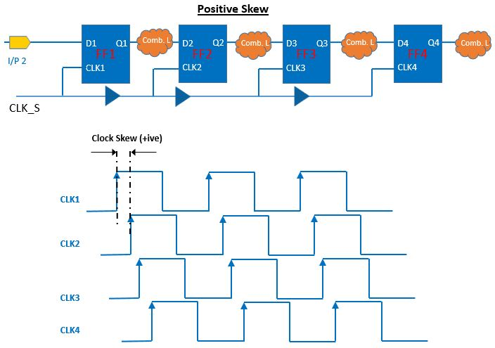

Slide 11
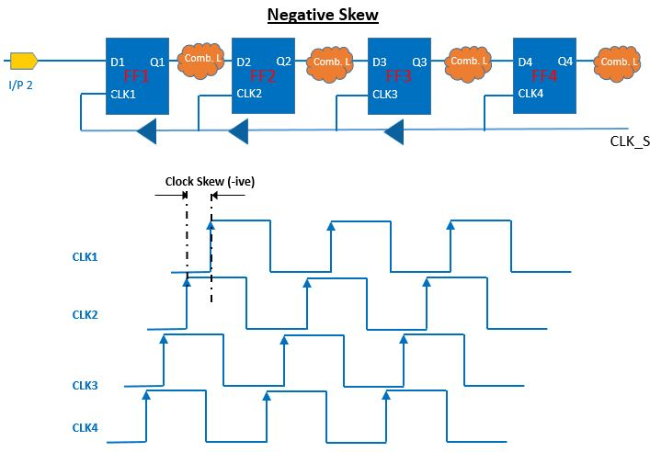

Slide 12
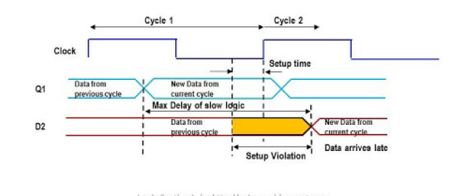
Setup time Violation
A setup time violation occurs when the input data to a flip-flop does not remain stable for the required setup time (tₛᵤ) before the active clock edge.

Slide 13
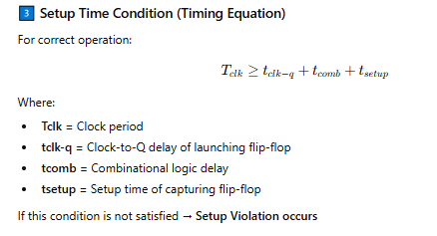

Slide 14
Causes of Setup Violation:
High combinational delay
Large clock skew
Increased routing delay
High operating frequency
Process/Voltage/Temperature (PVT) variations
Effects:
Wrong data captured
Metastability
Functional failure
System crash in high-speed designs
Methods to Fix Setup Violation:
✔ Reduce combinational delay ✔ Add pipeline registers ✔ Reduce clock frequency ✔ Improve clock skew ✔ Use faster cells ✔ Optimize placement and routing

Slide 15
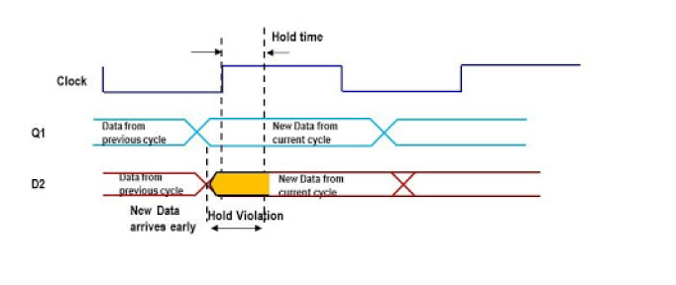
Hold time Violation
A hold time violation occurs when the input data to a flip-flop changes too soon after the active clock edge, violating the required hold time (tₕ).

Slide 16
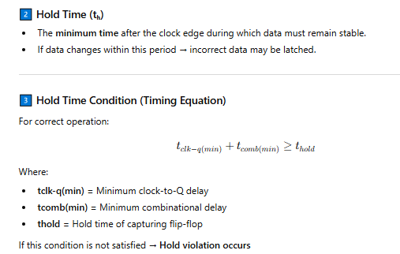

Slide 17
Causes of Hold Violation:
Very small combinational delay
Fast data path
Negative clock skew
Technology scaling (short channel effects)
PVT variations
Effects:
Data corruption
Metastability
Unstable system behavior
Difficult-to-debug timing errors
Methods to Fix Hold Violation:
✔ Add delay buffers in data path ✔ Increase combinational delay ✔ Adjust clock skew (reduce negative skew) ✔ Use slower cells ✔ Routing delay insertion

Slide 18
3.2 Introduction
The design of digital integrated circuits in VLSI systems can be realized using various logic design styles, each offering different trade-offs in terms of speed, power consumption, transistor count, area, noise immunity, and design complexity.
As technology scales into deep submicron and nanometer regimes, the choice of logic style plays a critical role in determining overall system performance and energy efficiency.
Broadly, logic circuits are classified into:
Clocked (Dynamic) Logic Design
Non-Clocked (Static) Logic Design

Slide 19
3.2.1 Non Clocked Logic Design
Non-clocked logic design refers to digital circuit styles that operate without the use of a global clock signal, where the output depends solely on the instantaneous values of the input signals.
In non-clocked logic circuits, computation occurs continuously and immediately after input transitions, eliminating the need for precharge and evaluation phases.
These logic styles are typically implemented using static circuit techniques, where complementary pull-up and pull-down networks ensure full voltage swing and reliable logic levels.
Unlike clocked dynamic logic, non-clocked logic does not rely on charge storage on capacitive nodes, thereby providing better noise margins and improved robustness against leakage and charge sharing effects.

Slide 20
Non Clocked Logic Design
Non-clocked logic design generally exhibits higher reliability and simpler timing requirements, as there is no need for clock distribution, clock skew management, or synchronization constraints.
However, such logic styles may require a larger number of transistors compared to dynamic logic, especially in high fan-in implementations.
Common examples of non-clocked logic include fully complementary CMOS logic, NMOS logic, pseudo-NMOS logic, Differential Cascade Voltage Switch Logic (DCVSL), and Pass Transistor Logic.
Due to their stability, simplicity, and robustness, non-clocked logic styles are widely used in general-purpose digital circuits and low-power applications.

Slide 21
Non Clocked Logic Design
CMOS logic
NMOS logic
Pseudo NMOS logic
Pass Transistor logic
Differential cascade voltage switch logic

Slide 22
1.CMOS Logic
A static CMOS gate is a combination of two networks, called the pull-up network (PUN) and the pull-down network.
The function of the PUN is to provide a connection between the output and VDD anytime the output of the logic gate is meant to be 1 (based on the inputs).
Similarly, the function of the PDN is to connect the output to VSS when the output of the logic gate is meant to be 0.
The PUN and PDN networks are constructed in a mutually exclusive fashion such that one and only one of the networks is conducting in steady state.
In this way, once the transients have settled, a path always exists between VDD and the output F, realizing a high output (“one”) or, alternatively, between VSS and F for a low output (“zero”).

Slide 23
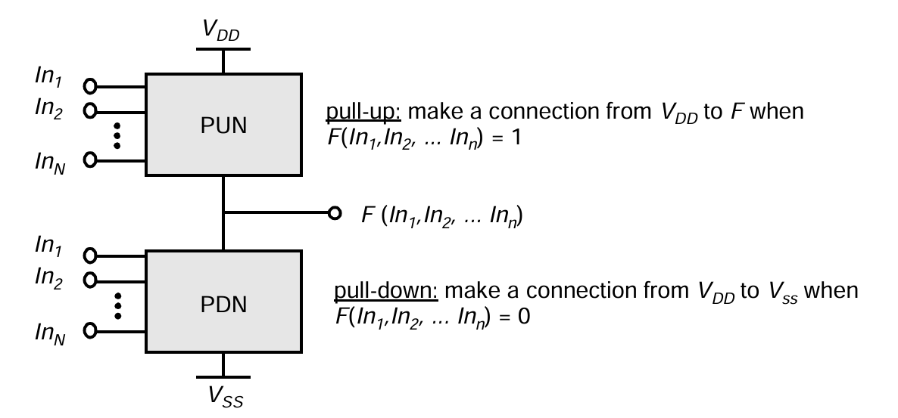
Figure 1: Complementary logic gate as a combination of a PUN (pull-up network) and a PDN (pull-down network).

Slide 24
CMOS Logic
A transistor can be thought of as a switch controlled by its gate signal.
An NMOS switch is on when the controlling signal is high and is off when the controlling signal is low.
A PMOS transistor acts as an inverse switch that is on when the controlling signal is low and off when the controlling signal is high.
The PDN is constructed using NMOS devices, while PMOS transistors are used in the PUN.
The primary reason for this choice is that NMOS transistors produce “strong zeros,” and PMOS devices generate “strong ones”.

Slide 25
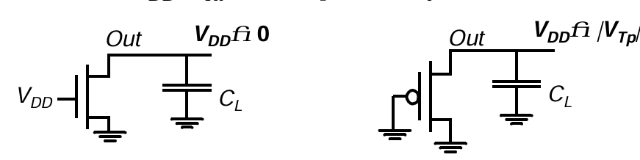
CMOS Logic
An NMOS device pulls the output all the way down to GND, while a PMOS lowers the output no further than |V_{Tp}| - the PMOS turns off at that point, and stops contributing dis charge current.
NMOS transistors are hence the preferred devices in the PDN.
Figure 2: pulling down a node using NMOS and PMOS switches

Slide 26
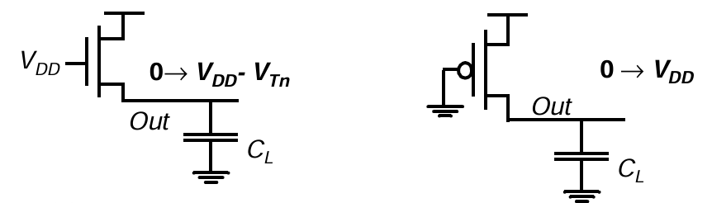
CMOS Logic
A PMOS switch succeeds in charging the output all the way to VDD, while the NMOS device fails to raise the output above V_{DD}-V_{Tn}.
This explains why PMOS transistors are preferentially used in a PUN.
Figure 3: pulling up a node using NMOS and PMOS switches

Slide 27




CMOS Logic
NMOS devices connected in series corresponds to an AND function. With all the inputs high, the series combination conducts and the value at one end of the chain is transferred to the other end.
Similarly, NMOS transistors connected in parallel rep resent an OR function.
A conducting path exists between the output and input terminal if at least one of the inputs is high. Using similar arguments, construction rules for PMOS networks can be formulated.
A series connection of PMOS conducts if both inputs are low, representing a NOR function ( = ), while PMOS transistors in parallel implement a NAND
( = ).

Slide 28
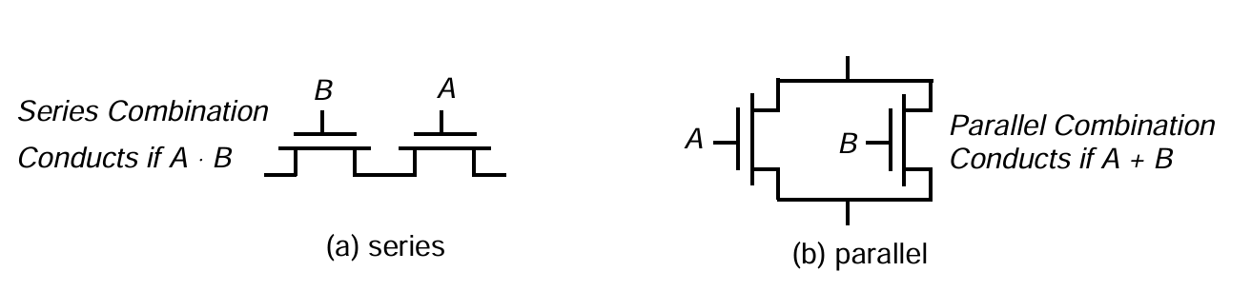
CMOS Logic
A parallel connection of transistors in the pull-up network corresponds to a series connection of the corresponding devices in the pull-down network, and vice versa.
Therefore, to construct a CMOS gate, one of the networks (e.g., PDN) is implemented using combinations of series and parallel devices.
The complementary gate is naturally inverting, implementing only functions such as NAND, NOR, and XNOR. The realization of a non-inverting Boolean function (such as AND OR, or XOR) in a single stage is not possible, and requires the addi tion of an extra inverter stage.
The number of transistors required to implement an N-input logic gate is 2N.

Slide 29
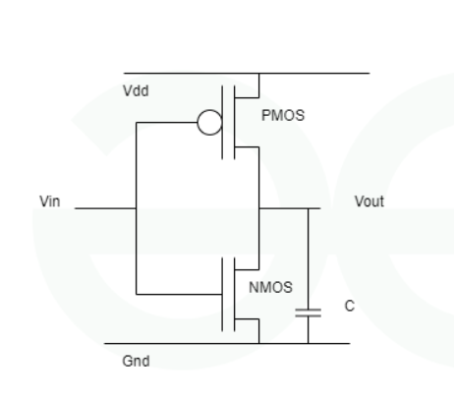
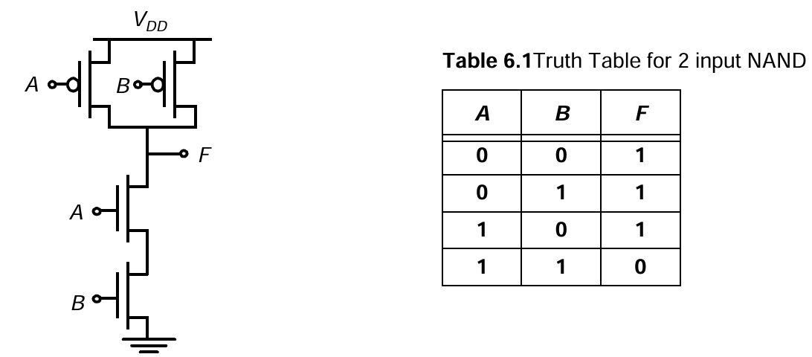
Figure 4: Inverter in complementary static CMOS style.
Figure 5: Two-input NAND gate in complementary static CMOS style.

Slide 30
CMOS Logic
Advantages:
1. Very Low Static Power Consumption
In steady state (logic 0 or 1), either PMOS or NMOS is OFF, so ideally no direct current flows from VDD to GND.
Power is mainly consumed during switching (dynamic power).
This makes CMOS ideal for battery-powered and portable devices.
2. High Noise Immunity
CMOS provides large noise margins.
Strong logic levels (full VDD for ‘1’ and 0V for ‘0’) reduce the chance of logic errors.
Very suitable for high-density integration.

Slide 31
CMOS Logic
3. High Input Impedance
MOSFET gates are insulated by oxide → almost zero DC input current.
Enables large fan-out capability.
Reduces loading effect on previous stages.
4. Rail-to-Rail Output Voltage
Output swings from 0 to V_{DD}.
Ensures strong logic levels and better signal integrity.
5. High Packing Density
CMOS technology supports very small transistor sizes.
Enables integration of millions to billions of transistors on a single chip.
Essential for modern microprocessors and SoCs.

Slide 32

CMOS Logic
Disadvantages:
1.Dynamic Power Consumption
Although static power is very low, CMOS consumes power during switching.
Dynamic power:
At high frequency and large capacitance, power becomes significant.
2. Short-Circuit Power
During switching, both PMOS and NMOS may conduct simultaneously for a short time.
This creates a direct path from VDD to GND → short-circuit current.

Slide 33
CMOS Logic
Disadvantages:
3. Leakage Power (Advanced Nodes)
In deep submicron technologies, leakage currents increase due to:
Subthreshold leakage
Gate oxide tunneling
Junction leakage
Leakage becomes a major issue in nanometer technologies.
4. Latch-Up Problem
Parasitic bipolar transistors in CMOS structure can form a Silicon Controlled Rectifier (SCR).
If triggered, it creates a low-resistance path between VDD and GND.
Can permanently damage the chip.

Slide 34
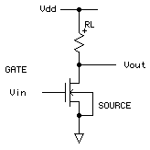
2. NMOS Logic
NMOS logic is a digital logic family that uses only NMOS (n-channel MOSFET) transistors to implement logic functions.
Logic is realized using pull-down networks (PDN).
A load (resistor or depletion NMOS) is used at the
output.
Popular before CMOS became dominant.
When the input is 0, the NMOS transistor is OFF,
and the output is pulled HIGH through the load.
When the input is 1, the NMOS transistor is ON,
and the output is pulled LOW to ground.

Slide 35
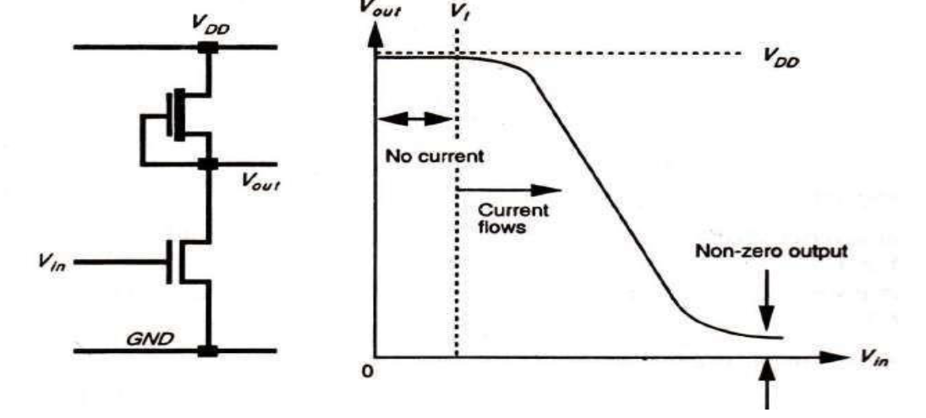
nMOS depletion mode transistor pull-up

Slide 36
This arrangement consists of a depletion mode transistor as pull-up. In this type of arrangement we observe
(a) Dissipation is high , since rail to rail current flows when Vin = logical 1.
(b) Switching of output from 1 to 0 begins when Vin exceeds Vt, of pull-down device
(c) When switching the output from 1 to 0, the pull-up device is non-saturated initially and this presents lower resistance through which to charge capacitive loads .

Slide 37
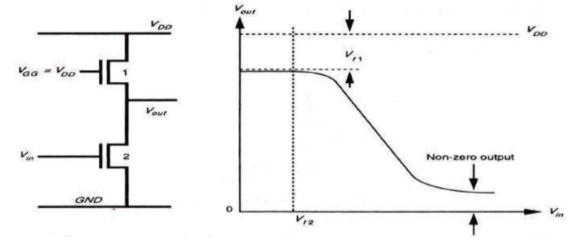
nMOS enhancement mode pull-up

Slide 38
The important features of this arrangement are
(a) Dissipation is high since current flows when Vin =logical 1 (V_{GG} is returned to V_{DD}) .
(b) Vout can never reach V_{DD} (logical I) if V_{GG} = V_{DD} as is normally the case.
(c) V_{GG} may be derived from a switching source, for example, one phase of a clock, so that dissipation can be greatly reduced.
(d) If V_{GG} is higher than V_{DD} then an extra supply rail is required.

Slide 39
Characteristics of NMOS Logic
Uses Only NMOS Transistors
Simpler fabrication.
Smaller area compared to early CMOS.
Faster Than PMOS Logic
Electrons (NMOS carriers) have higher mobility than holes (PMOS).
Therefore, NMOS circuits are faster than PMOS-only logic.
Static Power Dissipation
When output is LOW → continuous current flows from VDD to GND.
Hence higher static power compared to CMOS.

Slide 40
Advantages of NMOS Logic:
Faster than PMOS logic.
Requires fewer transistors than CMOS (in early implementations).
Simpler design structure.
Historically important in early microprocessor.
Disadvantages of NMOS Logic
High static power consumption.
Poor noise margin compared to CMOS.
Output HIGH voltage is weaker (depends on load).
More heat generation.
Not suitable for battery-operated systems.

Slide 41
3. Pseudo-NMOS Logic
Ratioed logic is an attempt to reduce the number of transistors required to implement a given logic function, at the cost of reduced robustness and extra power dissipation.
The purpose of the PUN in complementary CMOS is to provide a conditional path between VDD and the output when the PDN is turned off.
In ratioed logic, the entire PUN is replaced with a single unconditional load device that pulls up the output for a high output.
Instead of a combination of active pull-down and pull-up networks, such a gate consists of an NMOS pull-down network that realizes the logic function, and a simple load device.
A ratioed logic, which uses a grounded PMOS load and is referred to as a pseudo-NMOS gate.

Slide 42
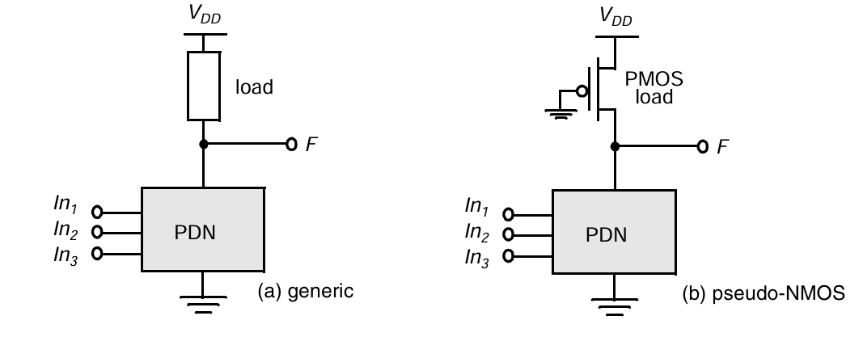

Slide 43
Pseudo-NMOS Logic
The clear advantage of pseudo-NMOS is the reduced number of transistors (N+1 versus 2N for complementary CMOS).
The nominal high output voltage (V_{OH}) for this gate is VDD since the pull-down devices are turned off when the output is pulled high (assuming that V_{OL} is below V_{Tn}).
On the other hand, the nominal low output voltage is not 0 V since there is a fight between the devices in the PDN and the grounded PMOS load device.
This results in reduced noise margins and more importantly static power dissipation.

Slide 44
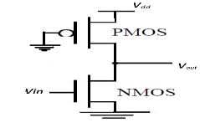
Pseudo-NMOS Logic
The sizing of the load device relative to the pull-down devices can be used to trade-off parameters such a noise margin, propagation delay and power dissipation.
Since the voltage swing on the output and the overall functionality of the gate depends upon the ratio between the NMOS and PMOS sizes, the circuit is called ratioed.

Slide 45
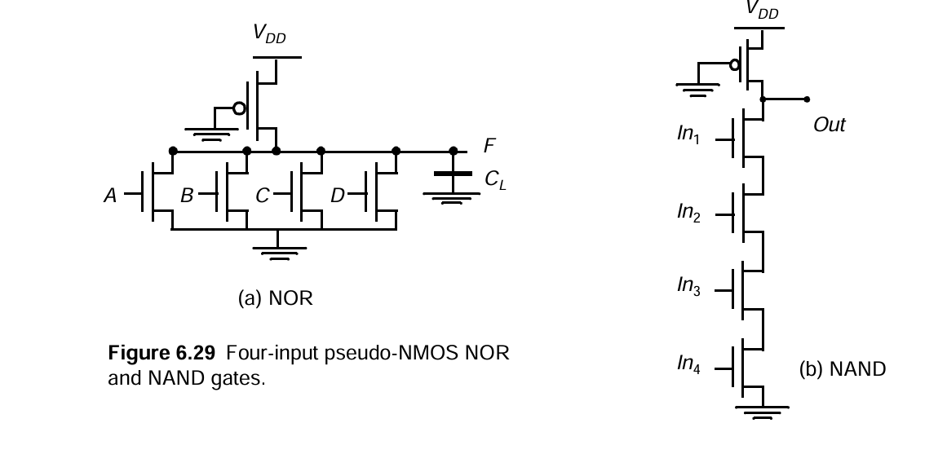

Slide 46
Advantages of Pseudo - NMOS Logic:
Reduced Transistor Count
Uses N + 1 transistors instead of 2N
Saves silicon area
Smaller Area
Less routing complexity
Compact design
Potentially Faster Rise Time
Only one PMOS load (simpler pull-up structure)

Slide 47
Disadvantages of Pseudo - NMOS Logic:
Static Power Dissipation
During LOW output, both PMOS and NMOS conduct
Direct current path from VDD to GND
High static power consumption
Reduced Noise Margins
Output LOW is not exactly 0 V
Noise immunity is lower than CMOS
Voltage Swing Degradation
LOW level depends on sizing
Not full rail-to-rail in worst cases
Careful Sizing Required
Performance depends on transistor ratio
Improper sizing → logic failure

Slide 48
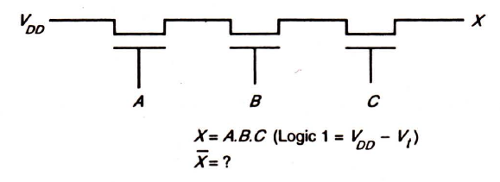


4. Pass Transistor Logic (PTL)
Unlike bipolar transistors, the isolated nature of the gate allows MOS transistors to be used as switches in series with lines carrying logic levels in a way that is similar to the use of relay contacts.
This application of the MOS device is called the Pass Transistor and switching logic arrays can be formed
Figure 6 : Pass transistor AND gate

Slide 49
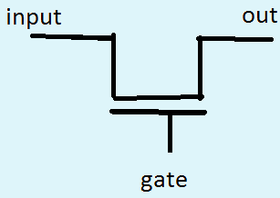

Pass Transistor Logic (PTL)
PTL uses a NMOS or PMOS transistor to transfer charge from input node to the output node, under the control of gate voltage. The output remains in High impedance state when gate voltage is zero.
Pass Transistor circuits are widely used in design of ROMs, PLAs, multiplexers etc

Slide 50
Defining STRONG and WEAK logic
Strong ‘1’: An output very close to the positive supply rail (V_{DD})
Weak ‘1’: An output voltage that is above V_{IH} but lower than a Strong ‘1’
Strong ‘0’: An output very close to the negative supply rail (V_{ss})or Gnd
Weak ‘0’: An output that is below V_{IL} but higher than a Strong ‘0’
Signal | Range (in Volts)
Strong ‘1’ | 4.5-5
Weal ‘1’ | 3.5-4.5
Weak ‘0’ | 0.5-1.5
Strong ‘0’ | 0.0- 0.5
.

Slide 51
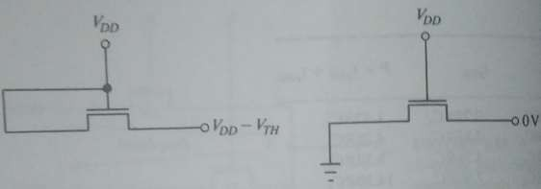
NMOS pass transistor passes Strong ‘0’ but weak ‘1’
An NMOS pass-transistor can pull down to the negative rail, but it can pull-up to a threshold voltage below the positive rail.
 => It can output a strong zero, but a weak one.

Slide 52
NMOS pass transistor passes Strong ‘0’ but weak ‘1’
For an NMOS to pass Logic ‘1’, the node Vs gets gradually charged from 0 towards V_{DD} .
When Vs reaches V_{DD}-V_{t,n} then
V_{GS}=(V_{G}- V_{S}) = V_{DD}-(V_{DD}-V_{t,n}) = V_{t,n}
which is the minimum voltage required for the NMOS to be ON state for a current to flow.
So node out reaching to a potential more than V_{DD}- V_{t,n} turns off the NMOS.

Slide 53

PMOS pass transistor passes Strong ‘1’ but weak ‘0’
An NMOS pass-transistor can pull down to the positive supply rail, but it can only pull-down to a threshold voltage above the negative rail.
 => It can output a strong zero, but a weak one.

Slide 54
PMOS pass transistor passes Strong ‘1’ but weak ‘0’
Similarly for a PMOS to pass logic ‘0’, gate should be logic 0 and the output node should be gradually discharged from its previous value to zero potential.
In this process when output node reaches |V_{t,p}| then |V_{SG}| reaches (|V_{t,p}|-0) which is the minimum voltage required for the PMOS to be ON state for a current to flow. So node out reaching to a potential less than V_{t,p} turns off the PMOS.
So the maximum voltage level that the output node can be discharged to is |V_{t,p}|

Slide 55
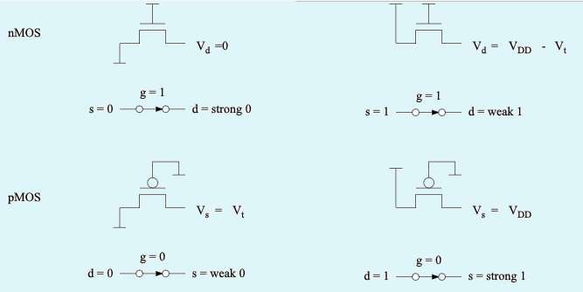
Strong and Weak Logic Summary
nMOS passes a strong Logic ‘0’ but a degraded Logic ‘1’. The opposite is true for pMOS

Slide 56
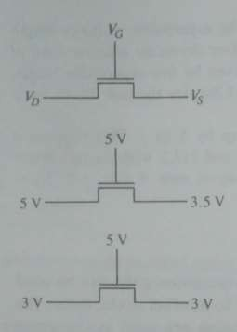
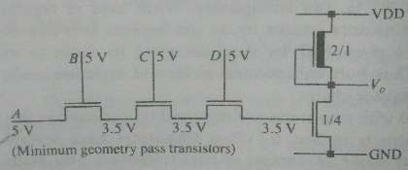
The source voltage is always the lower of voltages V_{D} and V_{G}-V_{T}

Slide 57
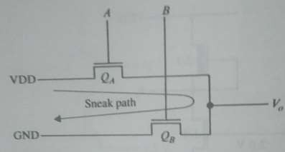
Advantages
They are not ratioed devices and can be minimum geometry
They do not have a path from VDD to ground and do not dissipate stand-by power
Limitations
A sneak path is created when two pass-transistors are both ON at the same time and one is connected to VDD and the other is connected to ground.

Slide 58
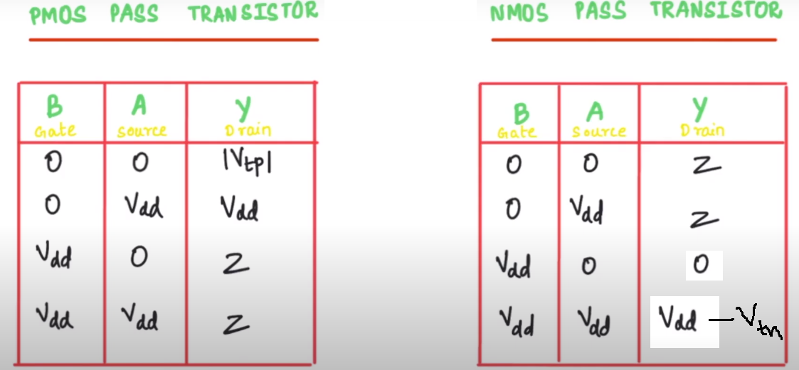

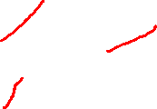
PMOS vs NMOS PTL

Slide 59
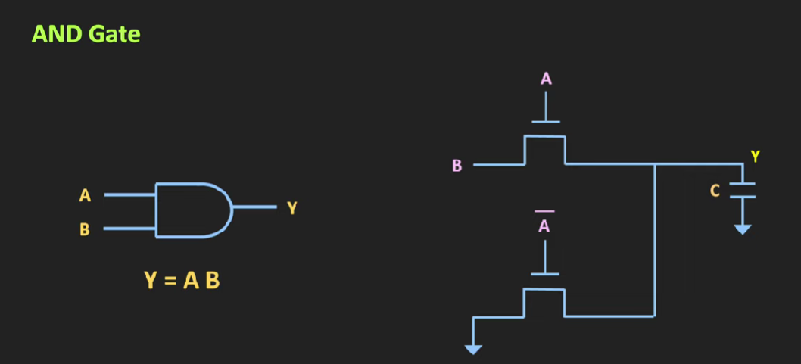

Slide 60
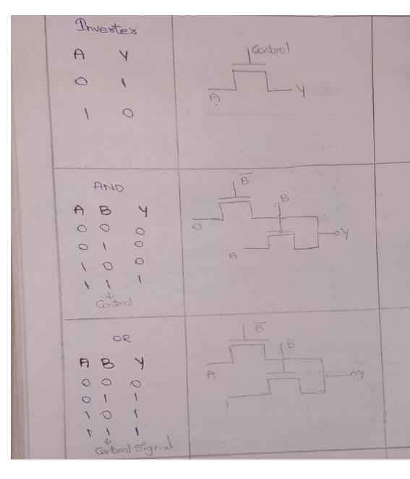

Slide 61
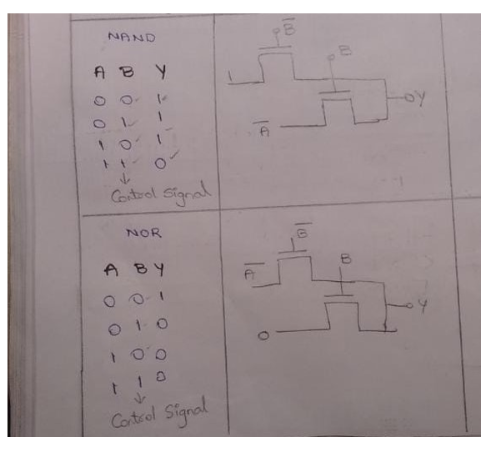

Slide 62
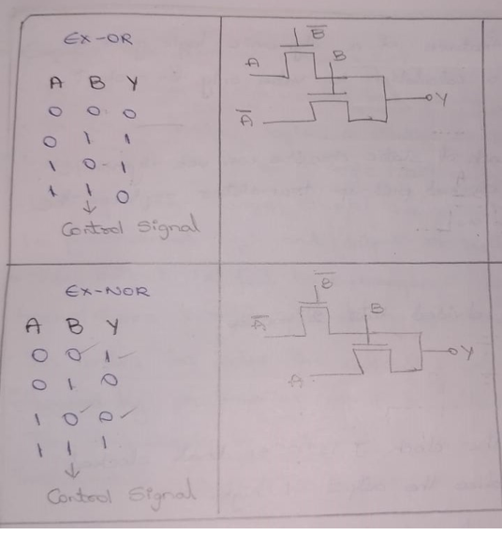

Slide 63
5. Differential Cascode Voltage Switch Logic
It is possible to create a ratioed logic style that completely eliminates static currents and provides rail-to-rail swing.
Such a gate combines two concepts: differential logic and positive feedback.
A differential gate requires that each input is provided in complementary format, and produces complementary outputs in turn. The feedback mechanism ensures that the load device is turned off when not needed.
A example of such a logic family, called Differential Cascode Voltage Switch Logic (or DCVSL).

Slide 64
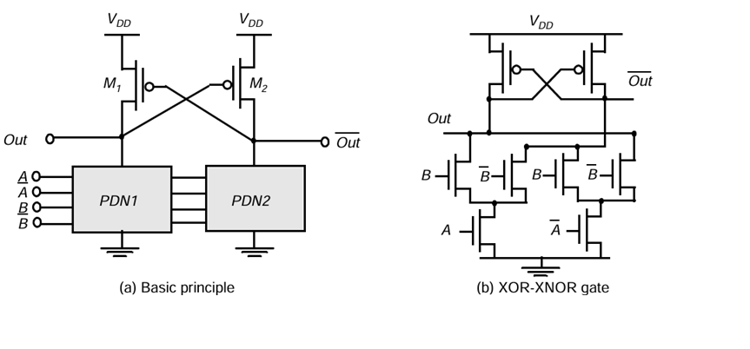
Figure 7: DCVSL logic gate.

Slide 65
Differential Cascode Voltage Switch Logic
In some logic functions such as XOR/XNOR, transistors can be shared between PDN1 and PDN2. This reduces total transistor count, silicon area, and parasitic capacitance, leading to improved speed and lower implementation cost.
In addition to the problem of increase complexity in design, this circuit style still has a power-dissipation problem that is due to cross-over currents.
During the transition, there is a period of time when PMOS and PDN are turned on simultaneously, producing a short circuit path.

Slide 66
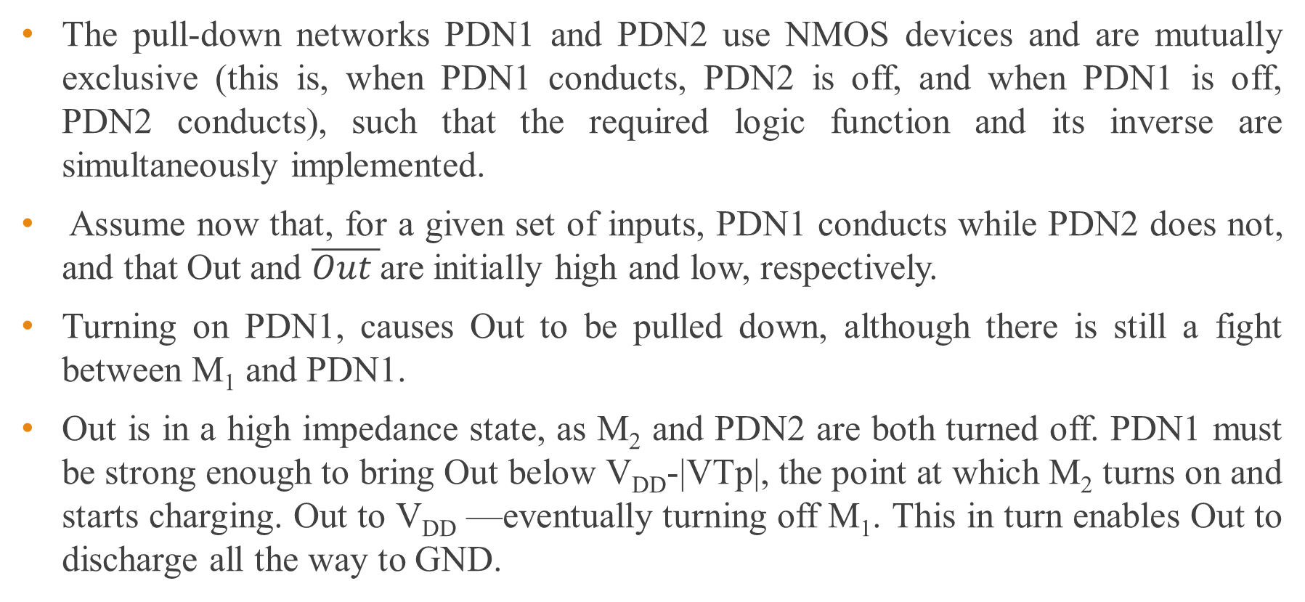
Differential Cascode Voltage Switch Logic
The pull-down networks PDN1 and PDN2 use NMOS devices and are mutually exclusive (this is, when PDN1 conducts, PDN2 is off, and when PDN1 is off, PDN2 conducts), such that the required logic function and its inverse are simultaneously implemented.
Assume now that, for a given set of inputs, PDN1 conducts while PDN2 does not, and that Out and $\overline{Out }$are initially high and low, respectively.
Turning on PDN1, causes Out to be pulled down, although there is still a fight between M₁ and PDN1.
Out is in a high impedance state, as M₂ and PDN2 are both turned off. PDN1 must be strong enough to bring Out below V_{DD}-|VTp|, the point at which M₂ turns on and starts charging. Out to V_{DD} —eventually turning off M₁. This in turn enables Out to discharge all the way to GND.

Slide 67
Advantages of DCVSL:
High Speed
Only NMOS devices are used in the pull-down path.
NMOS has higher electron mobility → faster switching.
Differential Outputs
Generates both F and F̅ simultaneously.
Eliminates need for extra inverter.
Useful in high-speed and noise-sensitive designs.
Good Noise Immunity
Differential operation improves noise rejection.
Better common-mode noise suppression.

Slide 68
No Static Power Dissipation
Like CMOS, it is a static logic family.
No direct path from VDD to GND in steady state.
Fast Switching Due to Positive Feedback
Cross-coupled PMOS provides regenerative action.
Improves transition speed.

Slide 69
Disadvantages of DCVSL:
Higher Transistor Count
Requires duplicated pull-down networks.
Larger area compared to simple CMOS gate.
Increased Design Complexity
More complex layout.
Careful matching required for symmetry.
Higher Input Capacitance
More transistors → larger input loading.
Can slow down previous stages.

Slide 70
Disadvantages of DCVSL:
Power Consumption
Dynamic power can be higher due to:
Charging/discharging two output nodes.
Additional internal nodes.

Slide 71
3.2.2 Clocked (Dynamic) Logic Design
Static CMOS logic with fan-in N requires 2N transistors (N PMOS + N NMOS).
To reduce transistor count, alternative logic styles were introduced:
Pseudo-NMOS logic
Pass Transistor Logic (PTL)
Pseudo-NMOS logic requires only N + 1 transistors for an N-input gate.
However, pseudo-NMOS suffers from static power dissipation due to a direct current path between VDD and GND.
To overcome this limitation, an alternative logic style called Dynamic Logic was introduced.

Slide 72
1. Clocked (Dynamic) Logic Design
Dynamic logic achieves reduced transistor count similar to pseudo-NMOS.
Unlike pseudo-NMOS, dynamic logic avoids static power consumption.
Dynamic logic requires the addition of a clock input.
The PDN (pull-down network) is constructed exactly as in complementary CMOS.
The operation of this circuit is divided into two major phases: precharge and evaluation, with the mode of operation determined by the clock signal CLK.

Slide 73
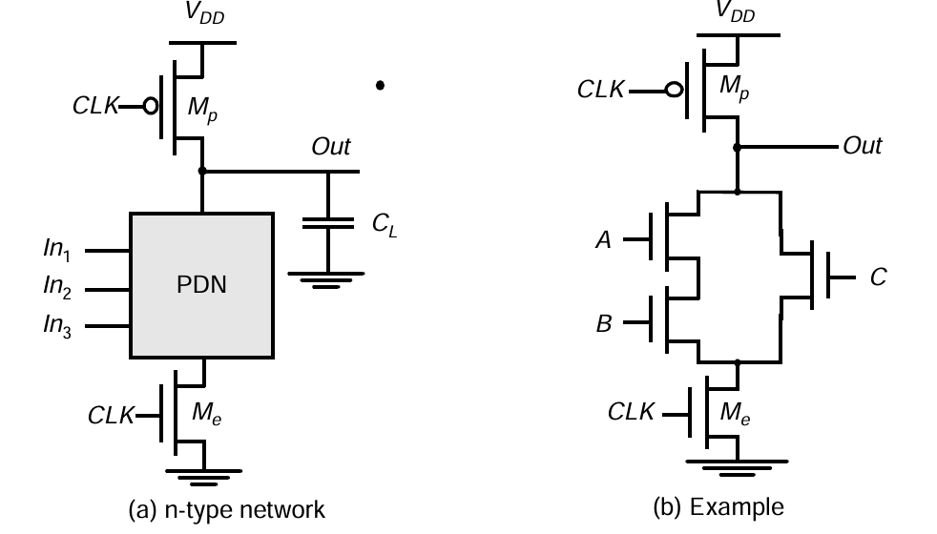
Figure 8: Basic concepts of a dynamic gate

Slide 74
Clocked (Dynamic) Logic Design
Precharge:
When CLK = 0, the output node Out is precharged to VDD by the PMOS transistor Mp.
During that time, the evaluate NMOS transistor Me is off, so that the pull-down path is disabled.
The evaluation FET eliminates any static power that would be consumed during the precharge period (this is, static current would flow between the supplies if both the pull down and the precharge device were turned on simultaneously).
Evaluation:
For CLK = 1, the precharge transistor Mp is off, and the evaluation transistor Me is turned on.

Slide 75
Clocked (Dynamic) Logic Design
The output is conditionally discharged based on the input values and the pull-down topology.
If the inputs are such that the PDN conducts, then a low resistance path exists between Out and GND and the output is discharged to GND.

Slide 76
Cascading Dynamic Logic Gates
Besides the signal integrity issues, there is one major catch that complicates the design of dynamic circuits: straightforward cascading of dynamic gates to create more complex structures does not work.
During the precharge phase (i.e., CLK =0), the outputs of both inverters are precharged to VDD. Assume that the primary input In makes a 0 → 1 transition.
On the rising edge of the clock, output Out1 starts to discharge.
The second output should remain in the precharged state of VDD as its expected value is 1 (Out1 transitions to 0 during evaluation).
However, there is a finite propagation delay for the input to discharge Out1 to GND. Therefore, the second output also starts to discharge.

Slide 77
Cascading Dynamic Logic Gates
As long as Out1 exceeds the switching threshold of the second gate, which approximately equals VTn, a conducting path exists between Out2 and GND, and precious charge is lost at Out2.
The conducting path is only disabled once Out1 reaches VTn, and turns off the NMOS pull-down transistor.
This leaves Out2 at an intermediate voltage level. The correct level will not be recovered, as dynamic gates rely on capacitive storage in contrast to static gates, which have dc restoration.
The charge loss leads to reduced noise margins and potential malfunctioning.

Slide 78
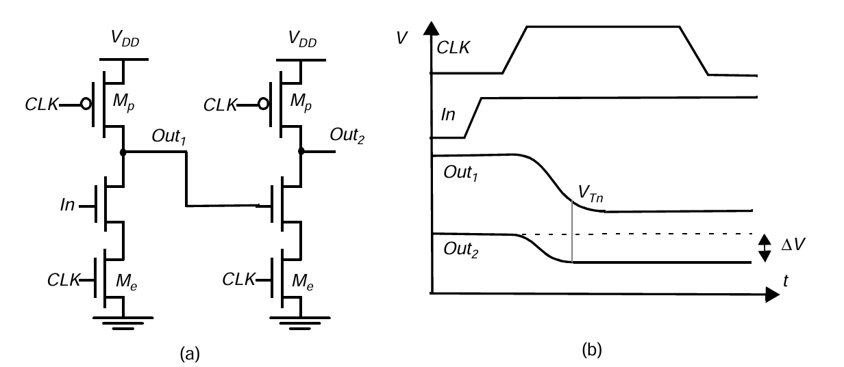
Figure 9: Cascade of dynamic n−type blocks

Slide 79
2. Domino Logic
A Domino logic module consists of an n-type dynamic logic block followed by a static inverter.
The dynamic stage performs conditional discharge based on input combinations, while the inverter restores full logic levels and provides strong output drive.
During precharge, the output of the n type dynamic gate is charged up to VDD, and the output of the inverter is set to 0.
During evaluation, the dynamic gate conditionally discharges, and the output of the inverter makes a conditional transition from 0 → 1.
Only rising transitions occur during evaluation, ensuring stable cascading operation.

Slide 80
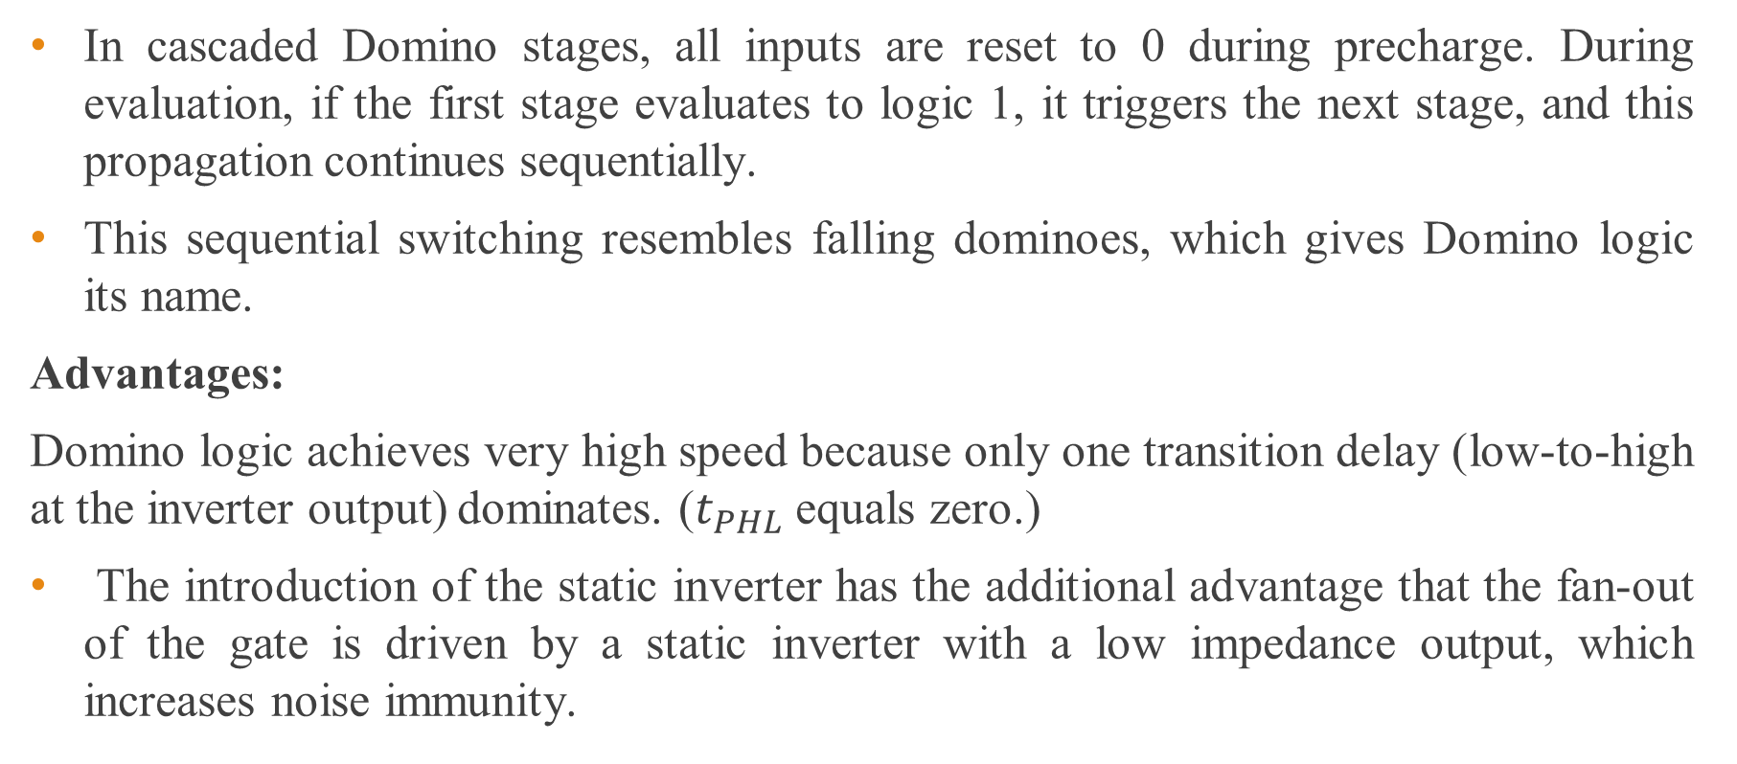
Domino Logic
In cascaded Domino stages, all inputs are reset to 0 during precharge. During evaluation, if the first stage evaluates to logic 1, it triggers the next stage, and this propagation continues sequentially.
This sequential switching resembles falling dominoes, which gives Domino logic its name.
Advantages:
Domino logic achieves very high speed because only one transition delay (low-to-high at the inverter output) dominates. ($t_{PHL}$ equals zero.)
The introduction of the static inverter has the additional advantage that the fan-out of the gate is driven by a static inverter with a low impedance output, which increases noise immunity.

Slide 81
Domino Logic
The buffer furthermore reduces the capacitance of the dynamic output node by separating internal and load capacitances.
Limitation:
Domino logic inherently supports only non-inverting logic functions because the dynamic stage is always followed by an inverter. Implementing inverting logic requires additional design techniques, which increases complexity.
Due to this limitation, pure Domino logic is less common in modern large-scale digital systems.

Slide 82
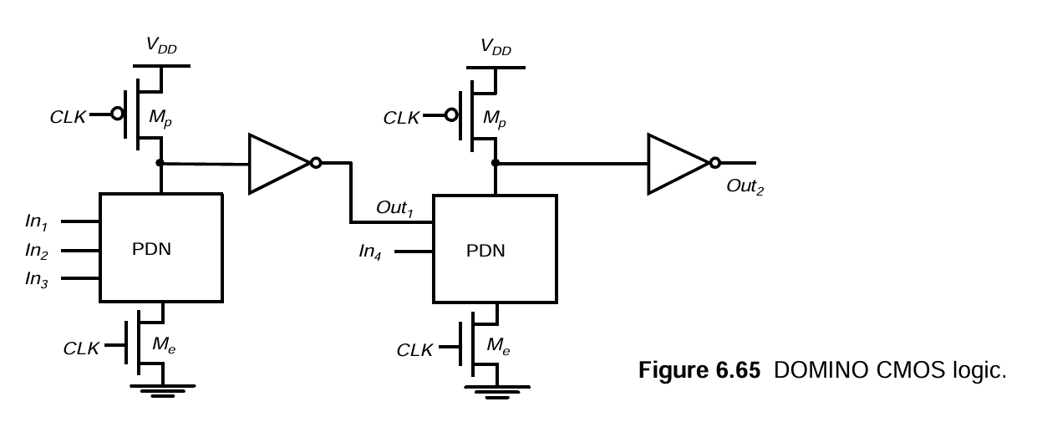
Figure 10: Domino CMOS logic

Slide 83
Domino Logic
Importance of Evaluation Transistor
Since all inputs of a Domino gate are forced to LOW during the precharge phase, it may appear that the evaluation transistor is unnecessary.
Removing this transistor seems attractive because it reduces the clock loading and improves the pull-down drive strength, potentially increasing evaluation speed.
However, eliminating the evaluation device introduces serious timing and power penalties that degrade overall circuit performance.
Impact on Precharge operation:
When the evaluation transistor is removed, the precharge operation no longer occurs simultaneously across all stages

Slide 84
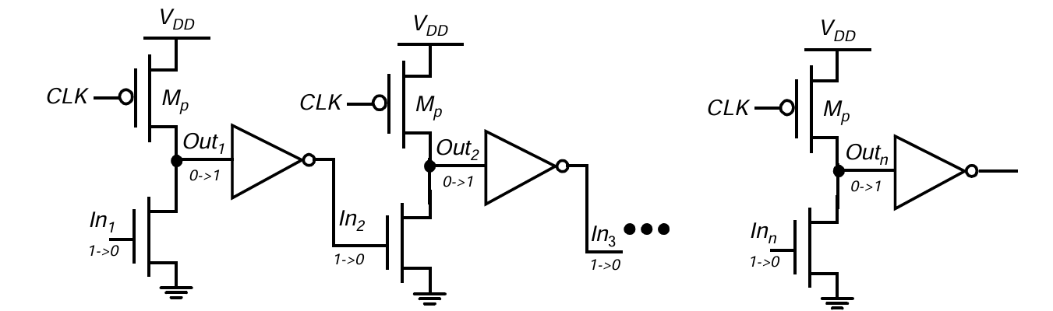
Domino Logic
Instead, the precharge must propagate sequentially through the logic network.
This happens because the pull-down network may remain active during the precharge phase, preventing the dynamic node from charging immediately.
Figure 11 : Effect of ripple precharge when the evaluation transistor is removed.

Slide 85
Domino Logic
If the primary input In1 is 1 during evaluation, the output of each dynamic gate is 0 and the output of each static inverter is 1.
On the falling edge of the clock, the precharge operation is started.
Assume further that In1 makes a high-to-low transition. The input to the second gate is initially high, and it takes two gate delays before In2 is driven low.
During that time, the sec ond gate cannot precharge its output, as the pull-down network is fighting the precharge device.
Similarly, the third gate has to wait till the second gate precharges before it can start precharging, etc.
Due to this sequential charging behavior, the total precharge time becomes approximately equal to the critical path delay of the logic network.

Slide 86
Domino Logic
This significantly reduces the speed advantage of Domino logic, which is designed to support fast parallel precharge and fast evaluation.
This significantly reduces the speed advantage of Domino logic, which is designed to support fast parallel precharge and fast evaluation.
Increased Power Consumption:
Another major drawback of removing the evaluation transistor is increased power consumption.
During precharge, both pull-up and pull-down devices may conduct simultaneously, creating a direct current path from VDD to ground.
This leads to short-circuit current and unnecessary power loss.

Slide 87
Domino Logic
Design Consideration:
To avoid increased delay and power dissipation, it is good design practice to always include evaluation transistors in Domino logic circuits.
The evaluation transistor isolates the pull-down network during precharge, allowing fast and simultaneous charging of dynamic nodes while maintaining low power operation.

Slide 88
Advantages
High Speed – Reduced input capacitance and fewer PMOS devices in pull-down path.
Lower Transistor Count – Compared to static CMOS for complex gates.
Smaller Area – Efficient implementation of wide fan-in logic.
Suitable for High-Performance CPUs – Used in high-speed datapath circuits.
Disadvantages
Requires Clock Signal – Needs precharge and evaluate phases.
Higher Dynamic Power – Output precharged every clock cycle.
Noise Sensitive – Charge sharing and leakage can cause errors.
Only Non-Inverting Logic – Cannot directly implement inverting functions.
Design Complexity – Careful timing and sizing required.

Slide 89
3. Differential Current Switch Logic
Differential Current Switch Logic (DCSL) is a high-speed clocked dynamic differential logic style that generates both true and complementary outputs using a differential NMOS pull-down network and cross-coupled PMOS load devices.
DCSL operates using a clock-controlled precharge and evaluation mechanism, where output nodes are precharged during the precharge phase and conditionally discharged during the evaluation phase based on the applied input combinations.
During evaluation, only one of the differential output nodes discharges, while the complementary node remains high, thereby producing a full-swing differential output signal.
Since DCSL relies on dynamic charge storage and eliminates static direct current paths between VDD and GND, it ideally consumes only dynamic switching power.

Slide 90
Differential Current Switch Logic
The differential structure of DCSL improves noise immunity, switching speed, and signal integrity compared to single-ended dynamic logic styles.
Due to reduced load capacitance and efficient current steering in the pull-down network, DCSL offers faster switching performance than conventional static CMOS logic.
However, DCSL requires careful clock distribution and is sensitive to charge leakage and clock-related power consumption.
DCSL is commonly used in high-performance datapath circuits, arithmetic units, and speed-critical digital systems where fast evaluation and differential signaling are required.

Slide 91
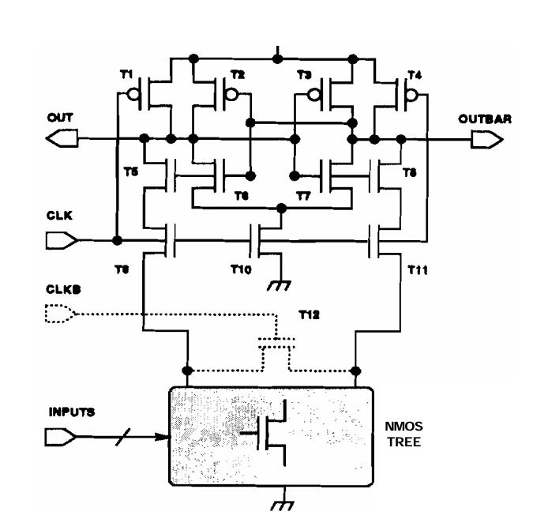
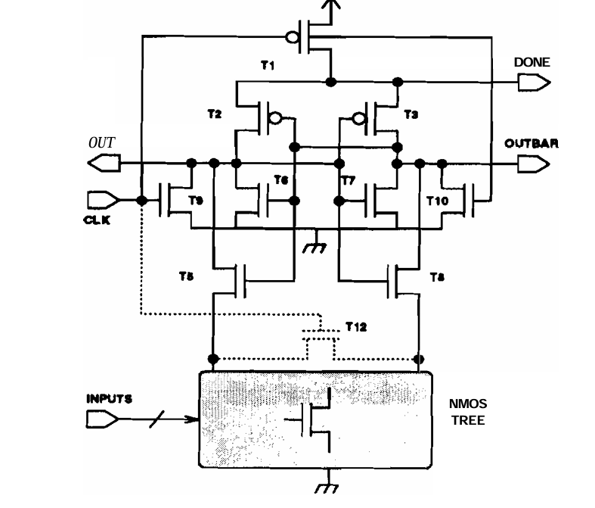
Figure 12 :Precharge high DCSL
Figure 13: Precharge low DCSL

Slide 92
Precharge high DCSL
Phase 1: Precharge Phase (CLK = LOW)
Both outputs OUT and OUTBAR are precharged HIGH (VDD).
Precharge transistors are ON.
Evaluation NMOS tree is inactive.
Outputs are initialized to logic ‘1’.
Phase 2: Evaluation Phase (CLK = HIGH)
Clock turns ON evaluation transistors.
Both outputs start discharging through the NMOS tree.
Due to differential input:
One side has a stronger pull-down path.
That output discharges faster.

Slide 93
Precharge high DCSL
The cross-coupled inverter acts as a sense amplifier:
Amplifies the small voltage difference.
Forces one output LOW.
Forces the other HIGH.
Key Feature: Automatic Lock-Out
When one output goes LOW:
Transistor T8 cuts off the NMOS tree from the HIGH output.
This disconnects the winning HIGH output from ground.
Prevents further discharge.
After evaluation:
No DC path from VDD to GND exists.
Inputs cannot disturb the output.

Slide 94
Precharge low DCSL
Phase 1: Precharge Phase (CLK = LOW)
Outputs are charged LOW (GND).
Clock load is smaller compared to precharge-high version.
Circuit is initialized to logic ‘0’.
Phase 2: Evaluation Phase (CLK = HIGH)
NMOS tree evaluates differential currents.
One side pulls up faster than the other.
Cross-coupled inverter senses the imbalance.
One output goes HIGH, the other stays LOW.
Important Characteristics
Produces completion signal (DONE).
Even lower internal voltage swings (~0.5V)

Slide 95
Precharge low DCSL
Lower clock loading.
More sensitive to imbalance — requires careful layout.

Slide 96
Advantages
Very High Speed – Fast switching due to differential current steering.
Low Voltage Operation – Works efficiently at reduced supply voltages.
Good Noise Immunity – Differential operation improves noise rejection.
Simultaneous Complementary Outputs – No need for extra inverter.
Reduced Voltage Swing (in some designs) – Faster transitions.
Disadvantages
Higher Transistor Count – Needs differential structure.
Larger Area – More devices compared to simple CMOS.
Higher Dynamic Power – Two outputs switching simultaneously.
Design Complexity – Careful matching required.
Layout Sensitivity – Differential circuits need symmetry.

Slide 97


3.3 Leakage Current in deep sub micrometer transistors
In deep submicrometer (DSM) transistors (technology nodes < 0.25 µm, especially < 90 nm), leakage current becomes a major design concern because device dimensions and threshold voltages are aggressively scaled.
Leakage current is the unwanted current that flows when a transistor is supposed to be OFF (V_{GS} < V_{T}).
But in deep submicron technologies:
This OFF-state current contributes to static power dissipation.

Slide 98
Leakage Current
As CMOS technology scales into the deep submicrometer regime, leakage current becomes a significant contributor to total power dissipation. Reduction in channel length, oxide thickness, and threshold voltage leads to several leakage components that were negligible in long-channel devices.
The major leakage mechanisms are:
Reverse-biased pn junction leakage
Subthreshold leakage
Gate oxide tunneling leakage
Hot carrier injection
Gate-Induced Drain Leakage (GIDL)
Punchthrough leakage

Slide 99
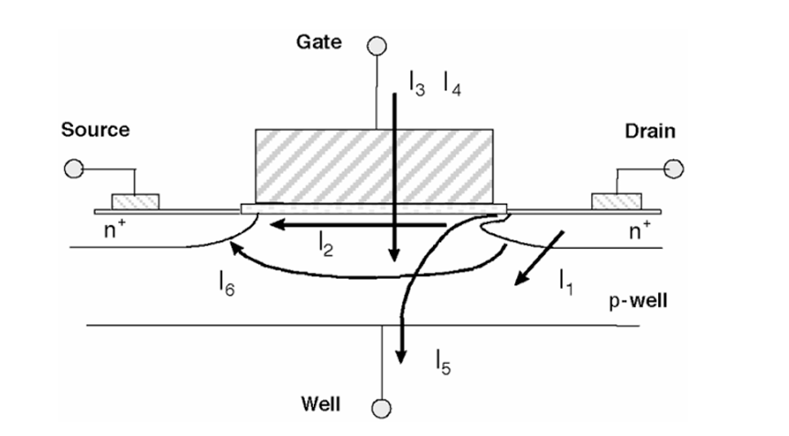
Figure 13: Summary of leakage current mechanisms of deep-submicrometer transistors.

Slide 100
Reverse-Bias pn Junction Leakage
Drain and source to well junctions are typically reverse biased, causing pn junction leakage current.
A reverse-bias pn junction leakage (I₁) has two main components:
i) minority carrier diffusion/drift near the edge of the depletion region.
ii) electron-hole pair generation in the depletion region of the reverse-biased junction.
pn junction reverse-bias leakage is a function of junction area and doping concentration. If both n and p regions are heavily doped band-to-band tunneling (BTBT) dominates the pn junction leakage.

Slide 101
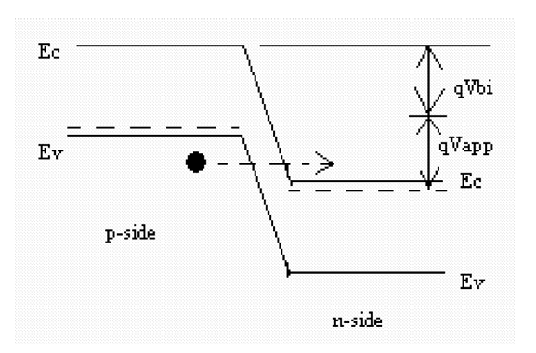
Reverse-Bias pn Junction Leakage
Band-to-Band Tunneling Current: High electric field (>10⁶ V/cm) across the reverse-biased pn junction causes significant current to flow through the junction due to tunneling of electrons from the valence band of the p region to the conduction band of the n region.
Figure 14: BTBT in reverse-biased pn junction

Slide 102

Reverse-Bias pn Junction Leakage
This increases exponentially with:
High junction doping
High reverse bias
Shallow junction depth
For band-to-band tunneling to occur in a reverse-biased pn junction, the total potential drop across the junction must be greater than the semiconductor bandgap energy. When
the valence band of the p-region aligns energetically with the conduction band of the n- region.

Slide 103
Reverse-Bias pn Junction Leakage
Under this condition, electrons can tunnel directly from the valence band to the conduction band through the narrow depletion region without thermal excitation.
This phenomenon becomes significant in heavily doped, short-channel devices where electric fields are extremely high.

Slide 104
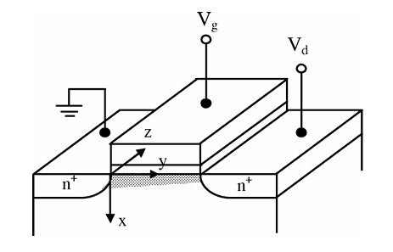
Subthreshold Leakage
Subthreshold or weak inversion conduction current between source and drain in an MOS transistor occurs when gate voltage is below V_{th.}
Even when the transistor is OFF, a weak inversion layer forms, allowing diffusion current between source and drain.

Slide 105
Subthreshold Leakage
Weak inversion region is the operating region of a MOSFET where the gate voltage is below the threshold voltage but sufficient to create a small concentration of minority carriers at the surface.
In this region, a weak inversion layer forms and current flows primarily due to diffusion.
The drain current varies exponentially with gate voltage and is known as subthreshold current.
When an n-channel MOSFET operates in weak inversion (Vg < Vth), the source is grounded and a small drain voltage is applied (Vds > = 0.1V). In this condition, most of the drain-to-source voltage drops across the reverse-biased drain–substrate pn junction, not along the channel.
Because of this, the variation of surface potential along the channel is very small. Therefore, the longitudinal electric field (along the channel) is also very small.

Slide 106
Subthreshold Leakage
Since:
The number of mobile carriers is small (weak inversion), and
The electric field along the channel is small, the drift current becomes negligible.
Hence, unlike strong inversion (where drift dominates), in weak inversion the current is mainly due to diffusion of carriers from source to drain.
In weak inversion, diffusion current dominates and the carrier concentration at the surface increases exponentially with gate voltage; therefore, the drain current also shows exponential dependence on gate voltage, appearing as a straight line on a semilog plot.

Slide 107

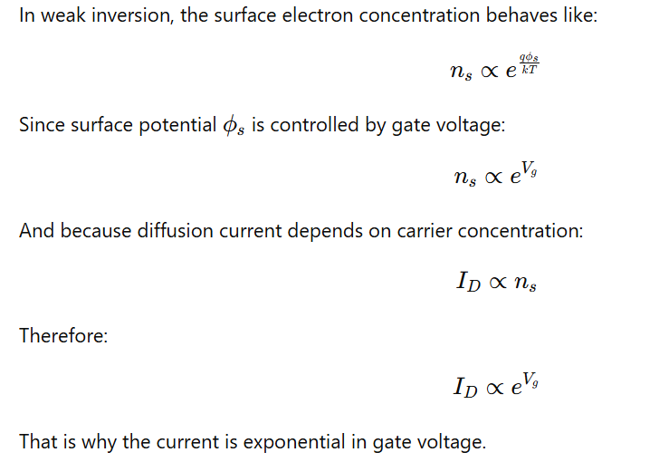
Subthreshold Leakage
If Vg increases slightly,the exponent increases, so the current increases very rapidly.

Slide 108
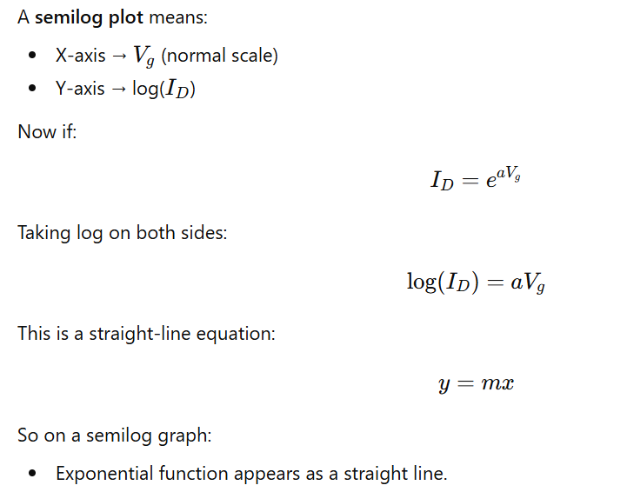

Slide 109
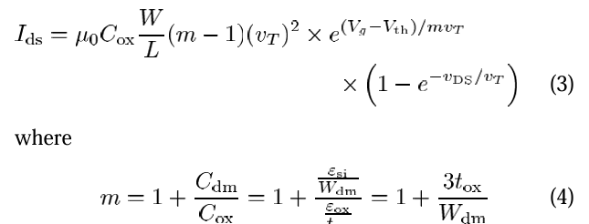
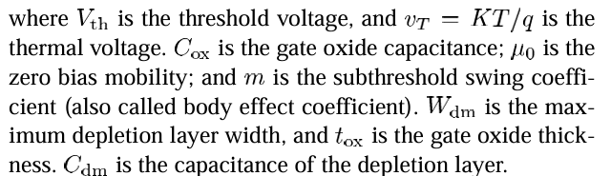
Subthreshold Leakage
The weak inversion current can be expressed based on the following:

Slide 110
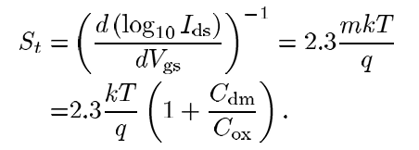
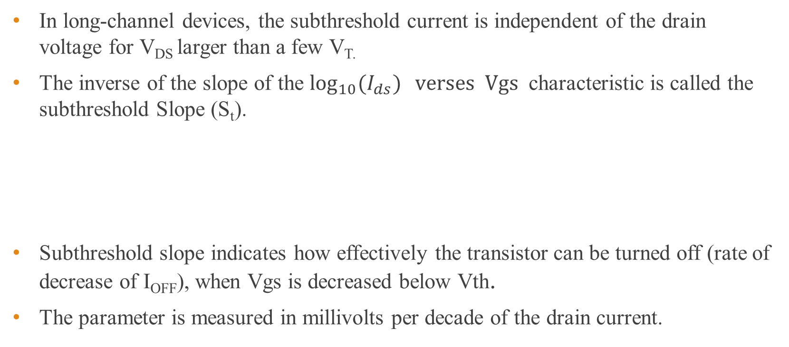
Subthreshold Leakage
In long-channel devices, the subthreshold current is independent of the drain voltage for V_{DS} larger than a few V_{T.}
The inverse of the slope of the $\log_{10}{(I_{ds})} verses Vgs$ characteristic is called the subthreshold Slope (S_{t}).
Subthreshold slope indicates how effectively the transistor can be turned off (rate of decrease of I_{OFF}), when Vgs is decreased below Vth.
The parameter is measured in millivolts per decade of the drain current.

Slide 111

Subthreshold Leakage
Ideal limit at room temperature:
$60 \text{mV}\text{/}\text{decade}$
Typical values for a bulk CMOS process can range from 70 to 120 mV/decade.
A low value for subthreshold slope is desirable.
It can be noted from the preceding expression that (St) can be made smaller by using a thinner oxide (insulator) layer to reduce t_{ox} or a lower substrate doping concentration.

Slide 112
Subthreshold Leakage
Factors Increasing Subthreshold Leakage:
Drain-Induced Barrier Lowering.
Body Effect.
Narrow-Width Effect.
Effect of Channel Length and threshold Rolloff.

Slide 113

1. DIBL (Drain Induced Barrier Lowering)
DIBL occurs when the drain voltage reduces the potential barrier at the source-channel junction, causing increased leakage currents even when the device is off.

Slide 114


Slide 115
In a long-channel MOSFET, when a high drain potential is applied, the energy bands near the drain bend downward.
Since a positive voltage is applied to the n⁺ drain, the drain–body junction is reverse biased, causing the drain depletion region to widen slightly.
However, this depletion region does not extend significantly into the channel, so the source–channel energy barrier remains almost unchanged.
As a result, the gate retains strong control over the channel, and the threshold voltage is nearly unaffected.

Slide 116
In a short-channel MOSFET, when a high drain potential is applied, the energy bands bend more strongly because the drain depletion region penetrates deep into the channel.
Due to the short channel length, the drain electric field reaches the source side, which lowers the source–channel energy barrier.
Consequently, electrons can flow from the source even when the gate voltage is below threshold, leading to increased off-state leakage current.
In this case, the drain significantly influences channel control, reducing the gate’s effectiveness—this phenomenon is known as Drain-Induced Barrier Lowering (DIBL).

Slide 117

Continue….
DIBL occurs when the depletion regions of the drain and the source interact with each other near the channel surface to lower the source potential barrier.
DIBL occurs for short-channel lengths, and it is further enhanced at high drain voltages. Ideally, the DIBL effect does not change the value of S_{t}, but does lower V_{th}.
Figure shows the DIBL effect as itshows the ID − VG curve for different gate voltages

Slide 118



Subthreshold Leakage
2. Body Effect:
Reverse biasing well-to-source junction of a MOSFET transistor widens the bulk depletion region and increases the threshold voltage.
The effect of body bias can be considered in the threshold voltage equation:
$V_{fb}$ = Flat band Voltage
$N_{a}$ = doping density in the substrate.
is the difference between the Fermi potential and the intrinsic potential in the substrate.
Higher VT → reduced leakage.

Slide 119
Subthreshold Leakage
3. Narrow-Width Effect:
The decrease in gate width modulates the threshold voltage of a transistor, and thereby modulates the subthreshold leakage. There are mainly three ways that narrow width modulates the threshold voltage.

Slide 120

Subthreshold Leakage
4. Effect of Channel Length and Threshold Rolloff:
As the channel length of a MOSFET decreases, the threshold voltage $V_{th}$ also decreases.
This reduction of threshold voltage with decreasing channel length is known as $V_{th}$ rolloff.
The main reason for this effect is the presence of two-dimensional (2-D) electric field patterns in short-channel devices.
In Long-Channel Devices:
Electric field is mostly one-dimensional (1-D).
Source and drain are far apart.
Their depletion regions do not significantly affect the channel potential.
Threshold voltage remains almost constant.

Slide 121
Subthreshold Leakage
In Short-Channel Devices:
Source and drain are very close.
Their depletion regions extend into the channel.
The source–drain distance becomes comparable to the vertical depletion width.
This creates a 2-D electric field distribution.
As a result:
Depletion regions from source and drain penetrate deeper into the channel.
Part of the channel is already depleted before gate voltage is applied.
The gate now needs to invert less bulk charge to form the channel, thereby lowering the threshold voltage.

Slide 122

Subthreshold Leakage
Effect of Drain Bias
The effect becomes more severe at high drain voltage:
Higher drain bias increases depletion region width.
More depletion charge enters the channel.
Threshold voltage reduces further.
Subthreshold current increases.
Figure : Threshold voltage rolloff with change in channel length; V reduction is more severe at higher drain bias.

Slide 123

Subthreshold Leakage
5. Effect of Temperature:
Subthreshold leakage current increases significantly with temperature because the subthreshold slope increases linearly with temperature and the threshold voltage decreases at approximately 0.8 mV/°C.
As a result, the OFF current rises exponentially with temperature. In the given 0.35 μm technology example, $I_{OFF}$increases by a factor of 356 between −50°C and 25°C, demonstrating the strong temperature dependence of subthreshold leakage.

Slide 124

Figure: I_{D} versus VG showing temperature sensitivity of I_{OFF}

Slide 125
Gate oxide tunneling leakage
Reduction of gate oxide thickness results in an increase in the field across the oxide.
The high electric field coupled with low oxide thickness results in tunneling of electrons from substrate to gate and also from gate to substrate through the gate oxide, resulting in the gate oxide tunneling current.
To understand the phenomenon of tunneling, consider an MOS capacitor with a heavily doped n+-type polysilicon gate and a p-type substrate. Also, for simplicity, let us now focus only on the electron tunneling.
When a positive bias is applied to the gate, due to the small oxide thickness, which results in a small width of the potential barrier, the electrons at the strongly inverted surface can tunnel into or through the SiO₂ layer and hence give rise to the gate current.

Slide 126

Gate oxide tunneling leakage
On the other hand, if a negative gate bias is applied, electrons from the n+ polysilicon can tunnel into or through the oxide layer and give rise to the gate current.
Figure: Tunneling of electrons through an MOS capacitor. (a) Energy-band diagram at flat-band condition. (b) Energy-band diagram with positive gate bias showing tunneling of electron from substrate to gate. (c) Energy-band diagram at negative gate bias showing tunneling of electron from gate to substrate

Slide 127


Gate oxide tunneling leakage
The mechanism of tunneling between substrate and gate polysilicon can be primarily divided into two parts, namely:
(1) Fowler–Nordheim (FN) tunneling, and (2) direct tunneling.
The tunneling probability of an electron depends on the thickness of the barrier, the barrier height, and the structure of the barrier.
Fowler-Nordheim Tunneling:
In FN tunneling, electrons tunnel into the conduction band of the oxide layer.
The current density in the FN tunneling is given by:
$E_{ox}$ - field across the oxide
$∅_{ox}$ - barrier height of electrons in conduction band
m* - effective mass of electron in conduction band of silicon

Slide 128


Gate oxide tunneling leakage
The FN current equation represents the tunneling through the triangular potential barrier and is valid for $V_{ox}$ > $∅_{ox}. where V_{ox}$ is voltage drop across the oxide.
Since $∅_{ox}=3.1 eV,short−channel devices mostly operate at$ $V_{ox}$ < $∅_{ox}$.
Thus, for normal device operation, the FN tunneling current is negligible.
Figure: FN tunneling of electrons

Slide 129


Gate oxide tunneling leakage
Direct Tunneling:
In very thin oxide layers (less than 3–4 nm), electrons from the inverted silicon surface, instead of tunneling into the conduction band of SiO_{2 ,} directly tunnel to the gate through the forbidden energy gap of the SiO₂ layer.
In the case of direct tunneling, electrons tunnel through a trapezoidal potential barrier instead of a triangular potential barrier.
Hence, the direct tunneling occurs at $V_{ox}$ < $∅_{ox}$
The equation governing the current density of the direct tunneling is given by:

Slide 130

Figure: Direct tunneling of electrons

Slide 131

Injection of Hot Carriers from Substrate to Gate Oxide
In a short-channel transistor, due to high electric field near the Si–SiO₂ interface, electrons or holes can gain sufficient energy from the electric field to cross the interface potential barrier and enter into the oxide layer .
This effect is known as hot-carrier injection. The injection from Si to SiO₂ is more likely for electrons than holes, as electrons have a lower effective mass than that of holes, and the barrier height for holes (4.5 eV) is more than that for electrons (3.1 eV)
Figure: Injection of hot electrons from substrate to oxide.

Slide 132
Gate-Induced Drain Leakage
Gate-Induced Drain Leakage (GIDL) is a leakage current that occurs in a MOS transistor due to very high electric fields in the drain–gate overlap region, particularly when the gate is at a low or negative voltage and the drain is at a high voltage.
It is mainly a high-field effect and becomes significant in short-channel and thin-oxide devices.
Low Negative Gate Bias:
When the gate is negatively biased:
Holes accumulate at the silicon surface under the gate.
The surface behaves like a heavily doped p-region.
This causes the depletion layer at the surface near the drain to become very narrow.

Slide 133
Gate-Induced Drain Leakage
Because the depletion region becomes narrow near the surface:
The electric field becomes highly concentrated.
This phenomenon is called field crowding.
The local electric field near the gate–drain overlap increases significantly.
High Negative Gate Bias:
Under strong negative gate bias:
The n+ drain region under the gate can become depleted.
It may even become inverted.
This further increases the electric field in that region.

Slide 134
Gate-Induced Drain Leakage
As the electric field increases:
Peak electric field becomes very high.
High-field effects such as avalanche multiplication and band-to-band tunneling (BTBT) increase dramatically.
Tunneling via surface traps also becomes more likely.
Physical Mechanism of GIDL:
Due to the strong electric field in the drain–gate overlap region:
Electrons from the valence band tunnel to the conduction band (BTBT).
Electron–hole pairs are generated near the surface.

Slide 135
Gate-Induced Drain Leakage
These newly generated minority carriers behave as follows:
Since the substrate is at a lower potential,
The minority carriers are swept laterally into the substrate.
This creates a leakage current path.
Thus, GIDL is essentially caused by band-to-band tunneling in the high-field drain region under the gate.
It is called gate-induced drain leakage because:
The leakage is triggered by the electric field created between the gate and drain.
The gate voltage strongly influences the depletion region shape and electric field intensity.
So even though the current flows near the drain, it is induced by the gate bias.

Slide 136

Figure: Condition of the depletion region near the drain-gate overlap region of an MOS transistor when (a) surface is accumulated with low negative gate bias; and (b) n+ region is depleted or inverted with high negative gate bias

Slide 137

Gate-Induced Drain Leakage
Factors That Increase GIDL:
Thin oxide thickness
Thinner oxide → stronger gate control → higher electric field → more tunneling.
Higher drain voltage
Higher $V_{DD}$→ stronger electric field between gate and drain.
Moderate drain doping
If doping is too low → electric field not strong enough.
If doping is too high → depletion width becomes very small, reducing tunneling volume.
Therefore, moderate doping causes maximum GIDL.

Slide 138
Gate-Induced Drain Leakage
Gate-Induced Drain Leakage (GIDL) is a leakage current mechanism caused by high electric fields in the gate–drain overlap region when the gate is negatively biased and the drain is at high voltage.
The negative gate bias causes surface accumulation and narrowing of the depletion region near the drain, leading to field crowding and strong electric fields.
These high fields enhance band-to-band tunneling, generating minority carriers that are swept into the substrate, producing leakage current. GIDL increases with thinner oxide thickness, higher drain voltage, and moderate drain doping.

Slide 139
Punch Through
Punchthrough is a short-channel effect that occurs when the depletion regions of the source and drain extend into the channel and merge with each other, causing a significant increase in subthreshold current even when the transistor is supposed to be OFF.
In short-channel devices:
The source and drain are very close to each other.
Each forms a depletion region with the substrate.
As channel length decreases, the separation between these depletion regions decreases.
If the doping concentration is kept constant and the channel length is reduced:
The depletion regions begin to approach each other.
Increasing the reverse bias (higher Vds) further widens these depletion regions.
When the depletion regions merge, punchthrough occurs.

Slide 140
Punch Through
Once punchthrough occurs:
The potential barrier between source and drain is lowered.
Majority carriers from the source can directly enter the substrate region.
Some of these carriers are collected by the drain.
As a result:
Subthreshold current increases significantly.
OFF-state leakage increases.
Subthreshold slope degrades.
Thus, punchthrough increases leakage even when Vgs=0.
The device parameter commonly used to characterize the punchthrough is the punchthrough voltage (V_{PT}) which estimates the value of Vds for which the punchthrough occurs at Vgs = 0.

Slide 141

Punch Through
It is roughly estimated as the value of the for which the sum of the widths of the drain and source depletion regions is equal to effective channel length
N_{B} = is the doping concentration at the bulk.
L = channel length
Wj = Junction width

Slide 142
3.4 Deep Submicrometer Device Design Issues
Deep submicrometer (DSM) technology refers to CMOS devices with channel lengths below 0.25 μm, and particularly in modern technologies below 100 nm.
Although scaling down device dimensions improves speed, packing density, and performance, it also introduces several serious design challenges due to short-channel effects, increased electric fields, quantum mechanical phenomena, and variability issues.
As the physical dimensions approach nanometer scale, classical device assumptions no longer hold, and leakage as well as reliability concerns become dominant factors in device design.

Slide 143
Deep Submicrometer Device Design Issues
i) Short-Channel Effects (SCE):
As the channel length decreases, the gate gradually loses complete electrostatic control over the channel region, and the influence of the source and drain depletion regions becomes significant.
In long-channel devices, the electric field distribution is primarily one-dimensional and controlled by the gate; however, in short-channel devices, two-dimensional field effects dominate, causing threshold voltage variations and leakage.
One important effect is threshold voltage rolloff, where the threshold voltage decreases as channel length reduces because part of the depletion charge in the channel is shared by the source and drain junctions.
This reduces the amount of charge that the gate must invert, thereby lowering the threshold voltage.

Slide 144
Deep Submicrometer Device Design Issues
Another major issue is Drain-Induced Barrier Lowering (DIBL), where a high drain voltage reduces the potential barrier at the source-channel junction, effectively lowering the threshold voltage and increasing subthreshold leakage current. As a result, the OFF-state current increases significantly in scaled devices.
In extreme scaling, punchthrough occurs when the source and drain depletion regions merge, creating a direct current path even when the gate voltage is zero. This results in large leakage current and degradation of subthreshold slope.

Slide 145
Deep Submicrometer Device Design Issues
ii) Increased Leakage Currents:
In deep submicrometer devices, leakage current becomes a major contributor to total power dissipation, often comparable to dynamic switching power.
The most dominant component is subthreshold leakage, which increases exponentially as threshold voltage is reduced for performance improvement. Since subthreshold current depends exponentially on (V_{GS} –V_{th}), even small reductions in threshold voltage cause large increases in leakage.
Another serious issue is gate oxide tunneling leakage, which arises because oxide thickness is aggressively scaled below 3–4 nm.
In such thin oxides, electrons can directly tunnel through the SiO₂ layer, destroying the assumption of infinite gate input impedance and increasing static power consumption.

Slide 146
Deep Submicrometer Device Design Issues
High electric fields in heavily doped junctions also cause band-to-band tunneling (BTBT), increasing reverse-bias junction leakage.
Additionally, Gate-Induced Drain Leakage (GIDL) occurs in the gate–drain overlap region due to high electric fields, especially when the gate is negatively biased and the drain is at high voltage.
Thus, leakage current management becomes a critical design concern in DSM technologies.

Slide 147
Deep Submicrometer Device Design Issues
iii) High Electric Field Effects:
As dimensions shrink, electric fields inside the transistor increase significantly because supply voltage scaling does not perfectly track dimension scaling.
High electric fields cause hot carrier injection, where energetic carriers are injected into the oxide, degrading device reliability over time.
Impact ionization and avalanche multiplication can also occur near the drain region, increasing substrate current and reducing device lifetime.
High fields near the oxide interface further increase gate leakage and oxide degradation.

Slide 148
Deep Submicrometer Device Design Issues
iv) Velocity Saturation and Mobility Degradation:
In short-channel devices, carriers quickly reach their saturation velocity due to high lateral electric fields.
As a result, the drain current becomes less dependent on channel length, reducing the performance benefit expected from scaling.
Furthermore, strong vertical electric fields near the Si–SiO₂ interface cause surface scattering of carriers, reducing mobility.
This mobility degradation reduces drive current and slows switching speed.

Slide 149
Deep Submicrometer Device Design Issues
v) Increased Power Density and Thermal Issues:
As transistor density increases dramatically in DSM technologies, more devices operate within a smaller area, leading to higher power density and heat generation.
Elevated temperatures further increase subthreshold leakage and degrade reliability. Therefore, thermal management becomes an essential part of deep submicrometer design.
vi) Variability and Process Fluctuations:
At nanometer dimensions, device performance becomes highly sensitive to small process variations.
Random dopant fluctuations, line-edge roughness, and oxide thickness variations cause significant threshold voltage variability.
This variability reduces yield and complicates circuit design, requiring statistical design techniques.

Slide 150
Deep Submicrometer Device Design Issues
viii) Quantum Mechanical Effects:
When device dimensions approach nanometer scale, quantum mechanical phenomena become significant.
Carrier quantization occurs in the channel, modifying threshold voltage. Direct tunneling increases gate leakage.
Classical device models must be modified to include quantum corrections.
ix) Interconnect and Parasitic Effects:
As devices shrink, interconnect resistance and capacitance increase due to thinner metal lines and closer spacing.
RC delay becomes comparable to transistor switching delay. Crosstalk and signal integrity issues also become more severe.

Slide 151
Deep Submicrometer Device Design Issues
x) Reliability Concerns:
Deep submicrometer devices suffer from several reliability issues such as:
Hot carrier degradation
Bias Temperature Instability (BTI)
Time-Dependent Dielectric Breakdown (TDDB)
Electromigration
These effects limit long-term device performance and lifetime.

Slide 152
Deep Submicrometer Device Design Issues
Deep submicrometer device design involves complex challenges including short-channel effects, increased leakage currents, high electric field phenomena, mobility degradation, thermal issues, variability, quantum mechanical effects, and reliability degradation.
While scaling improves performance and integration density, it introduces significant physical limitations that must be addressed using advanced techniques such as halo doping, retrograde wells, high-k dielectrics, strain engineering, and multi-gate devices like FinFETs.

Slide 153
Thank You

